Slide 1
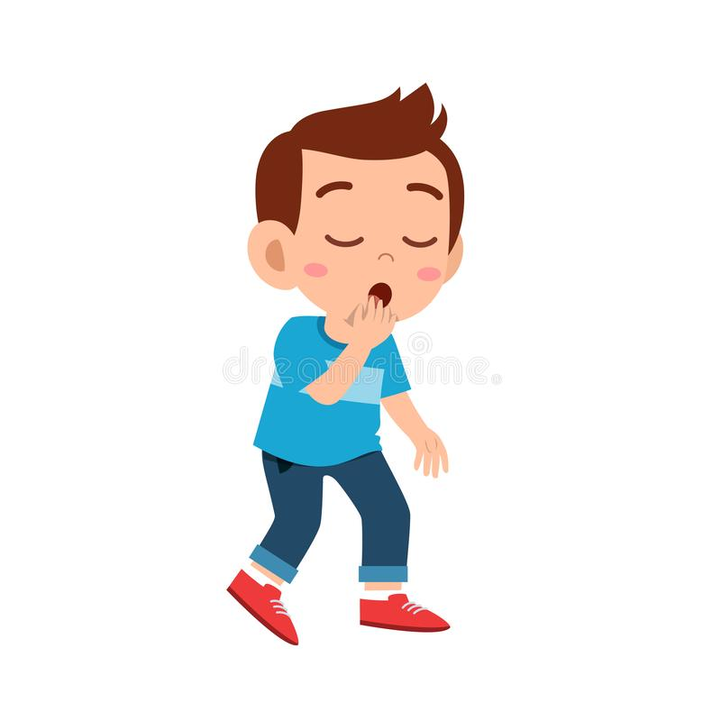
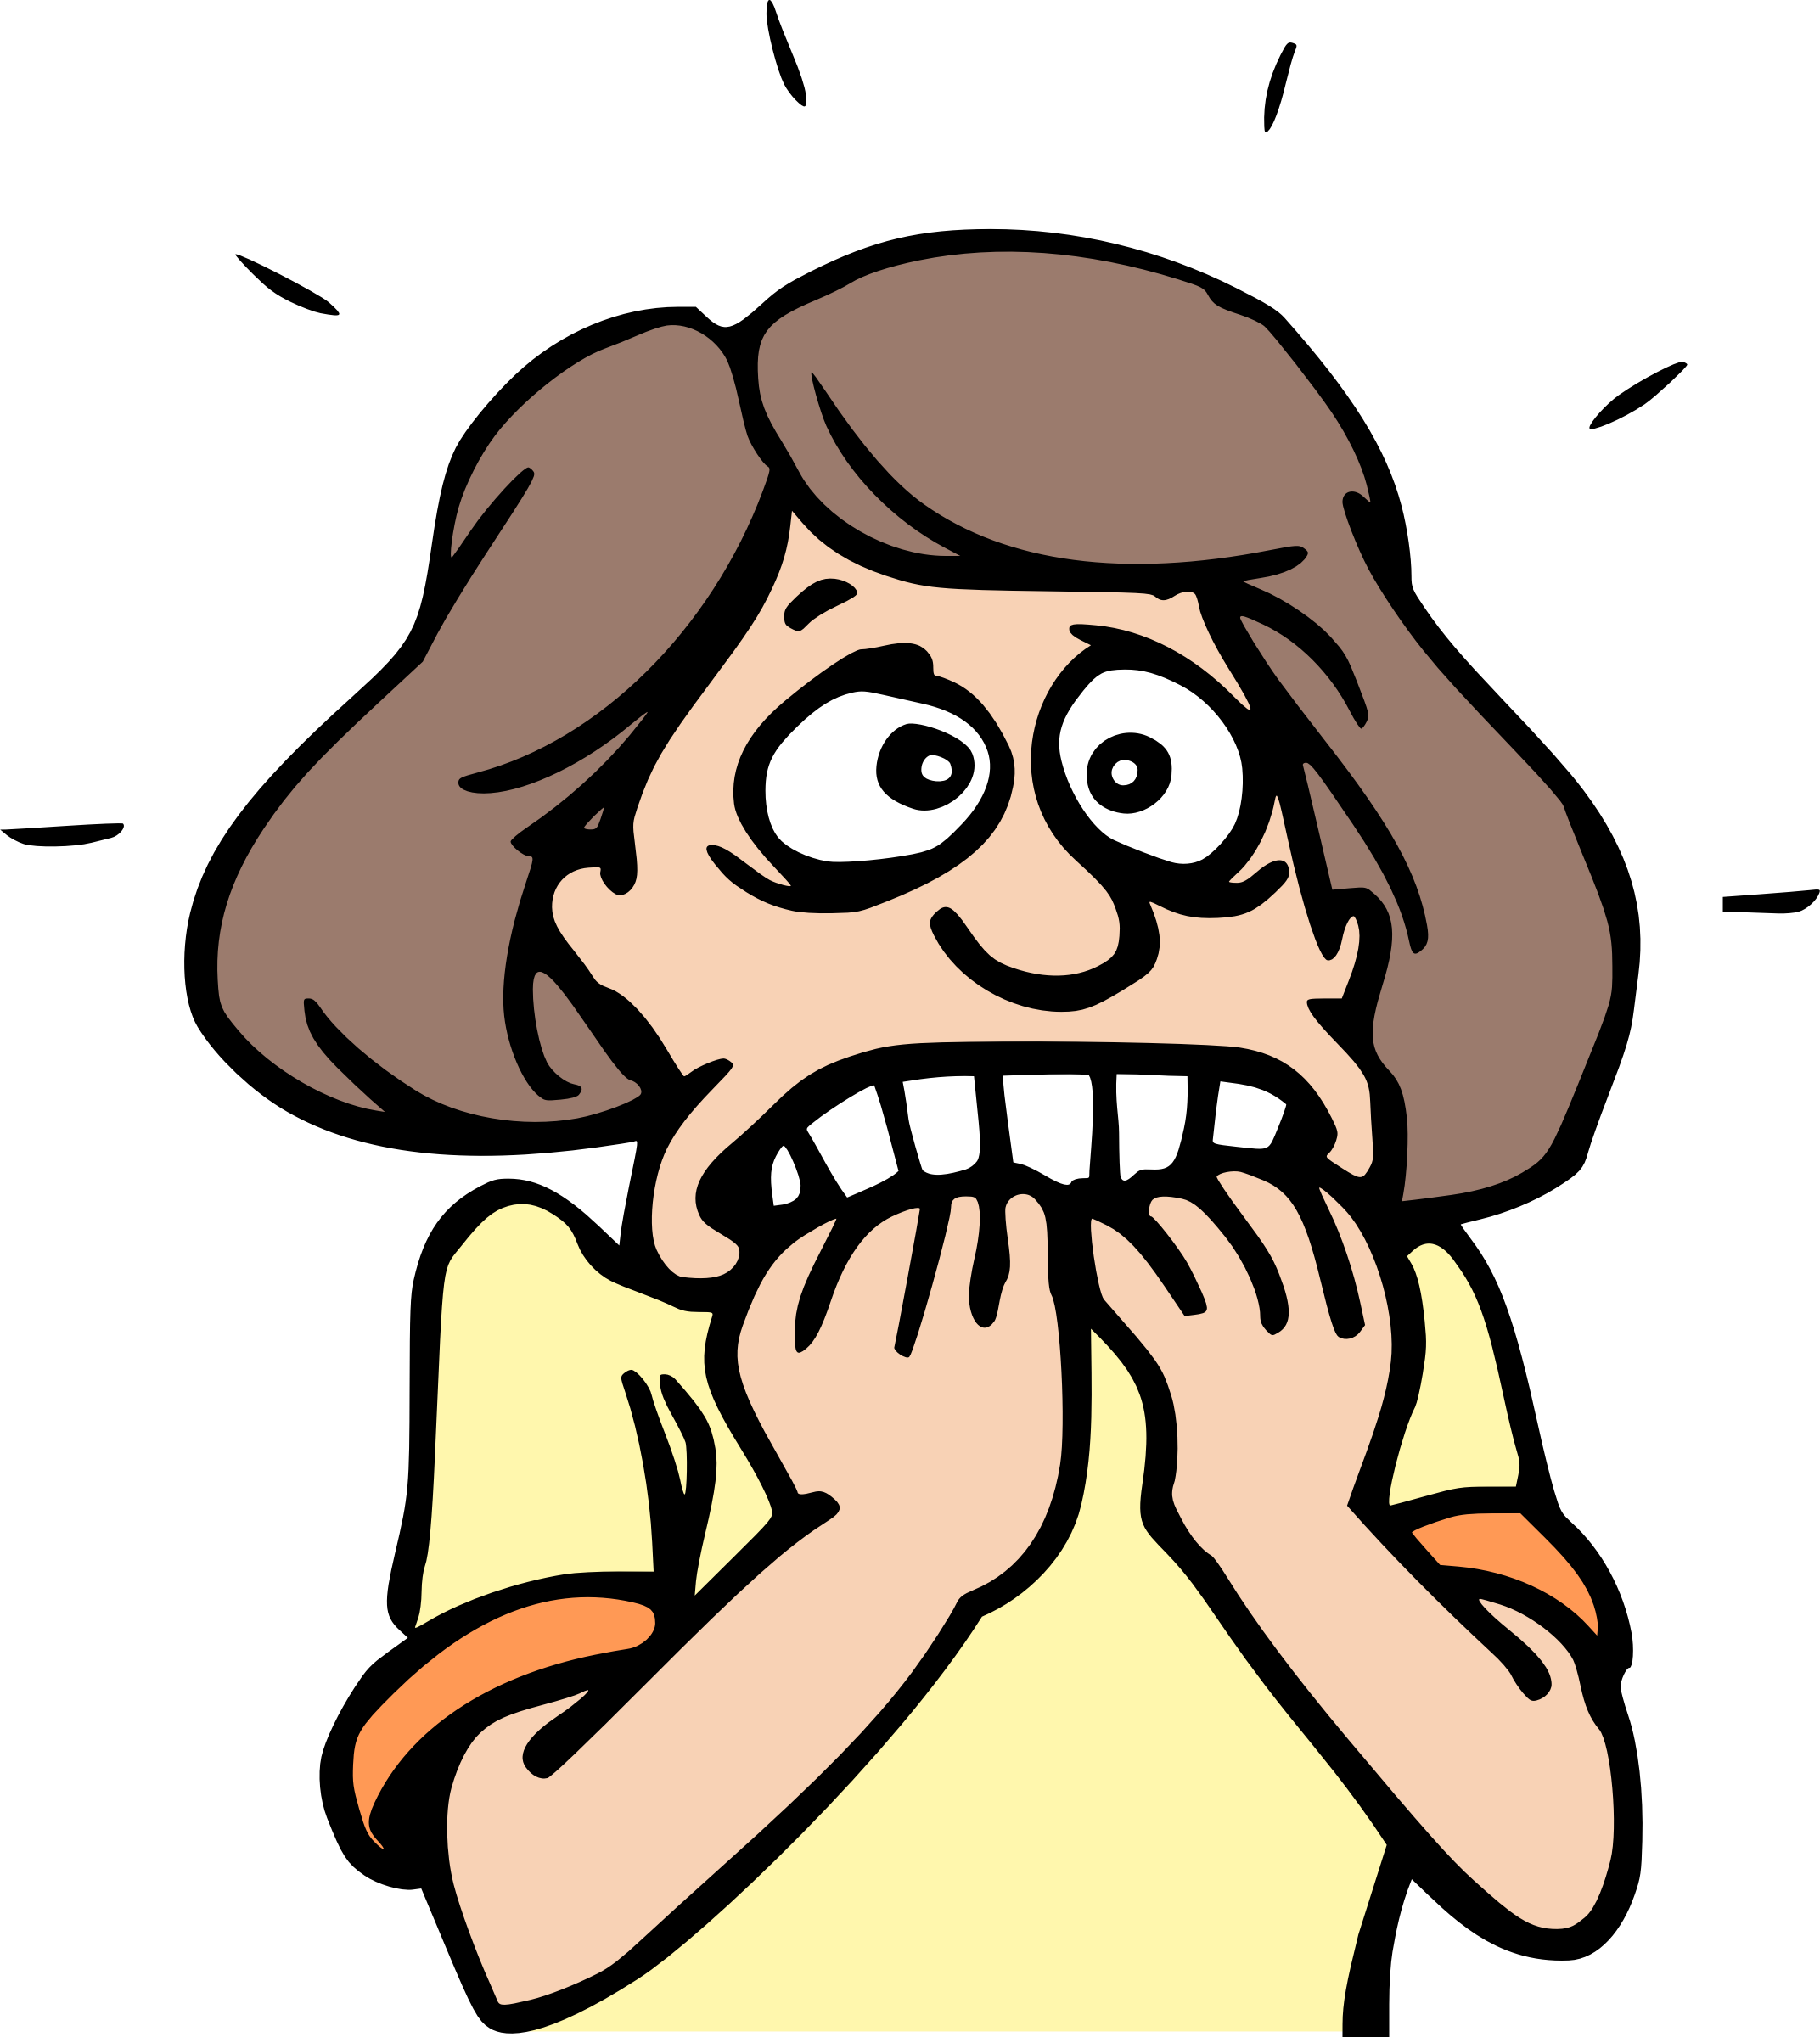
Welcome back to the English class !!!
How are you today ?
I’m tired
I’m nervous
I’m fine
What’s the date today ?
Today is Tuesday, the 8th of June
How’s the weather today?
It’s sunny and warm
Are you at school ?
Yes, I am at school

Slide 2
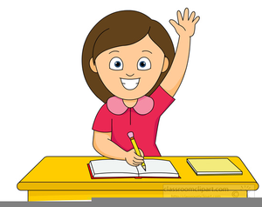
Class rules
Listen to the teacher
Raise your hand if you want to speak
Do the activities

Slide 3
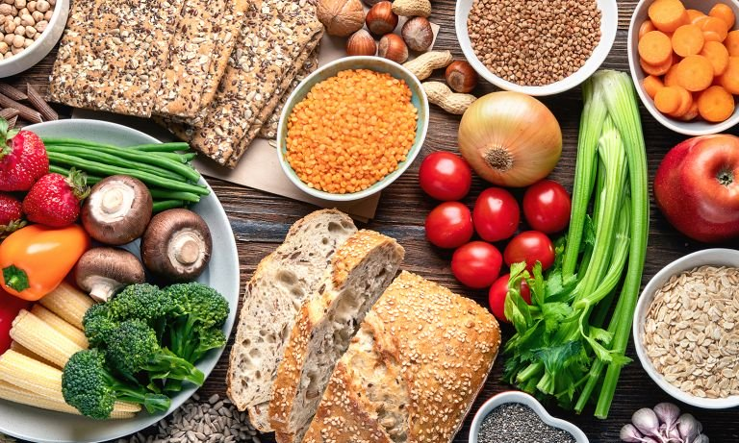
FOOD
Today, we’re going to talk about….
I like…
I don’t really like…
I hate…

Slide 4
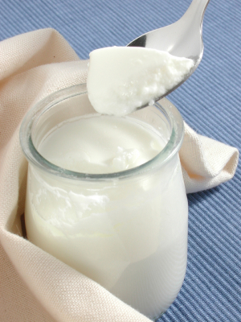
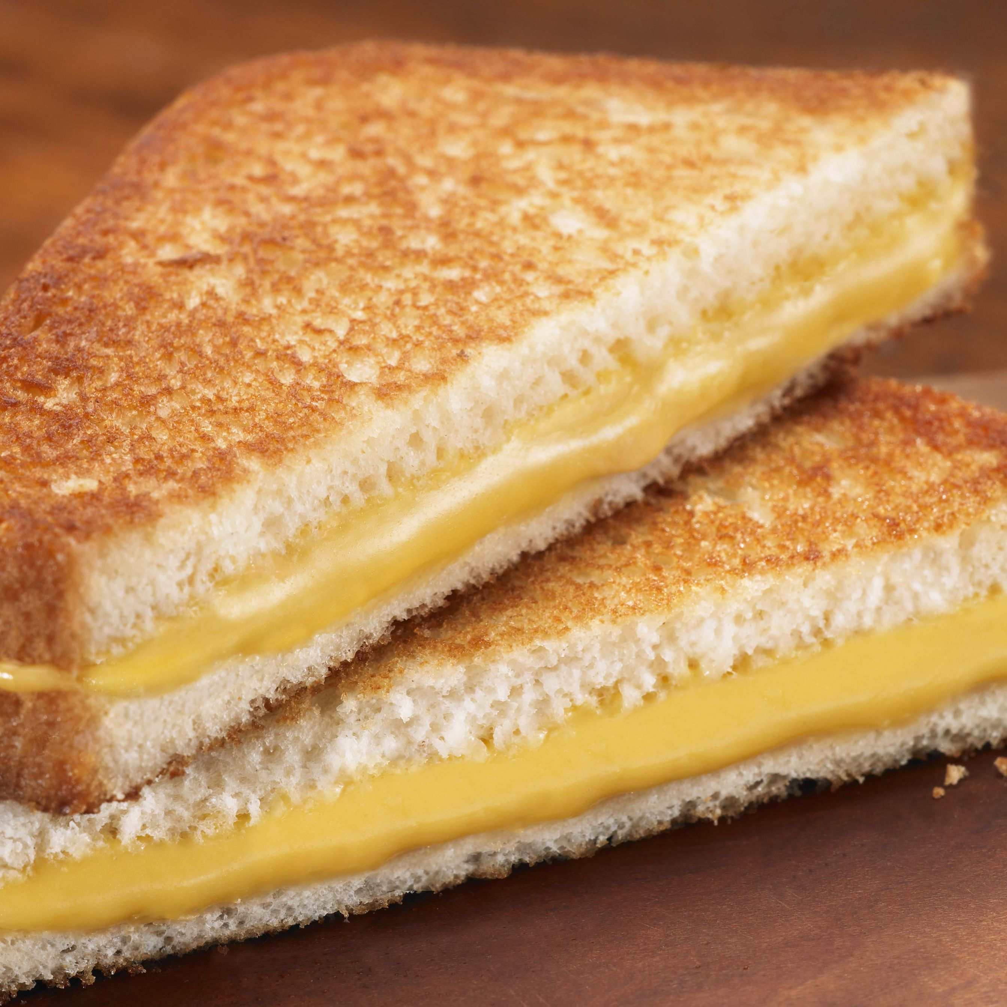
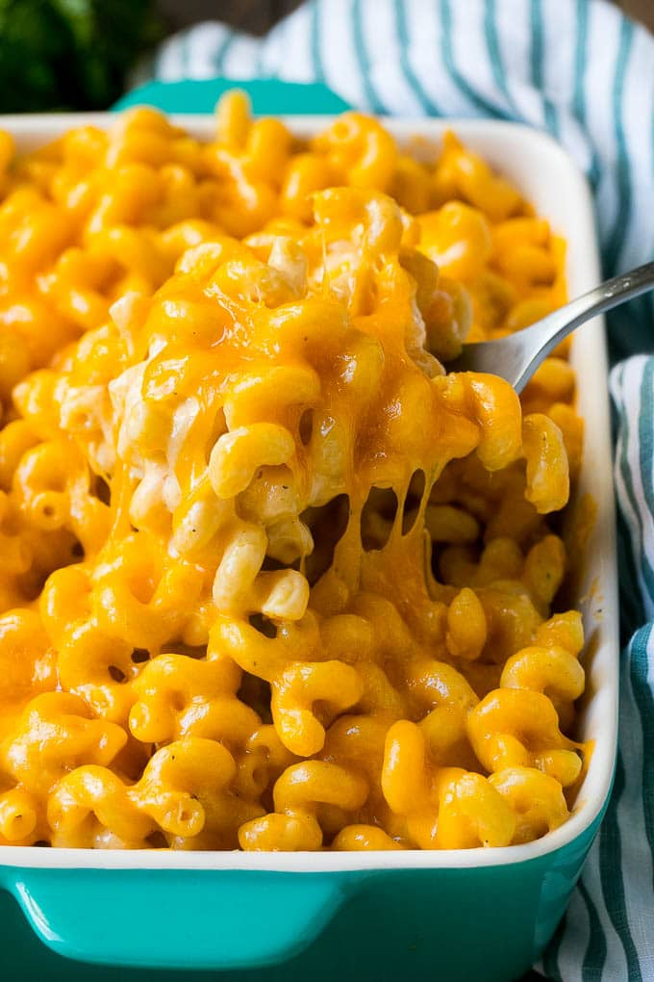
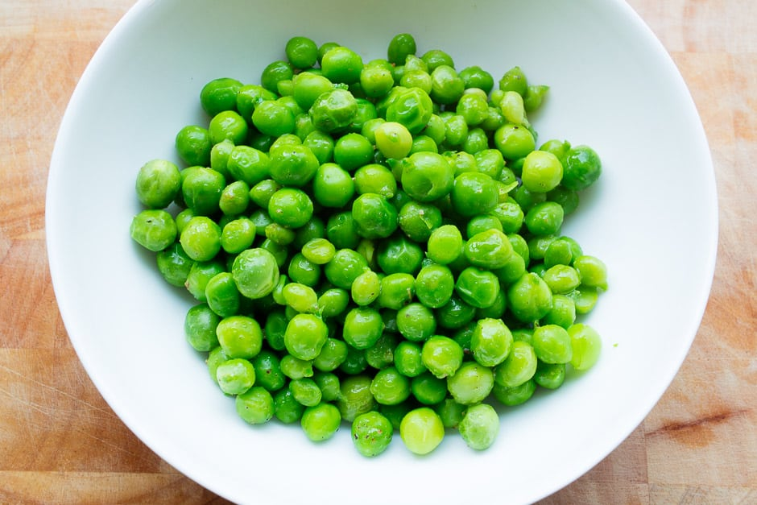
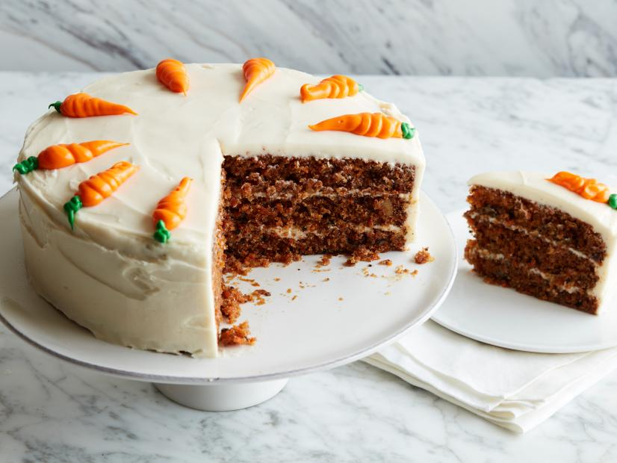
Pancakes
A grilled cheese sandwich
A cup of tea
A yogurt
A glass of water
A carrot cake
A glass of orange juice
An apple
Peas
Mac and cheese
I like…
I don’t really like…
I hate…

Slide 5
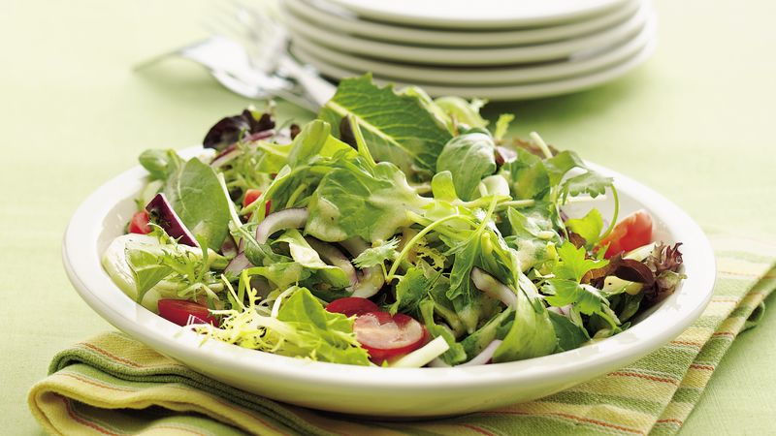
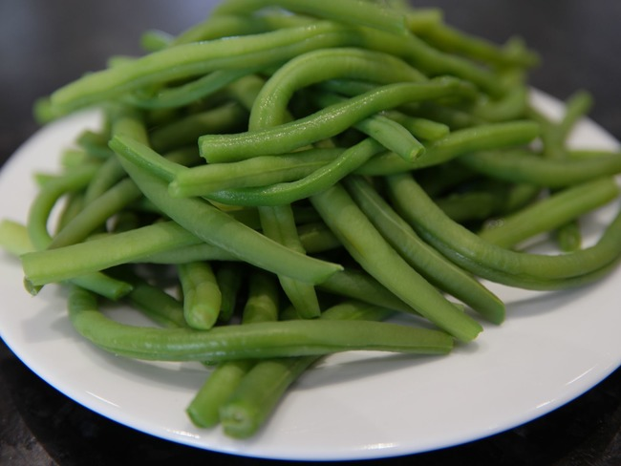
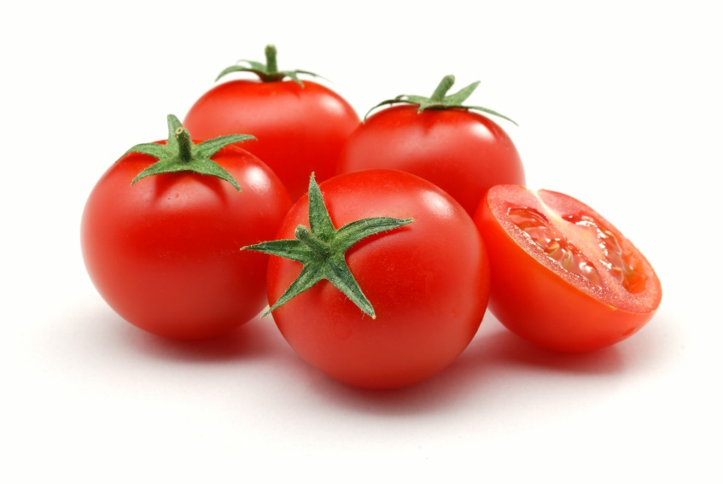
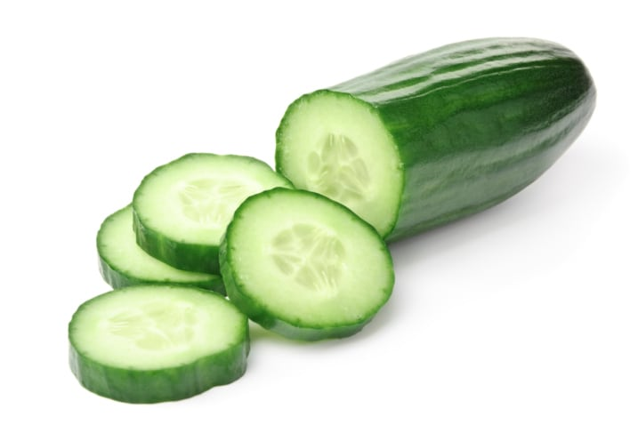
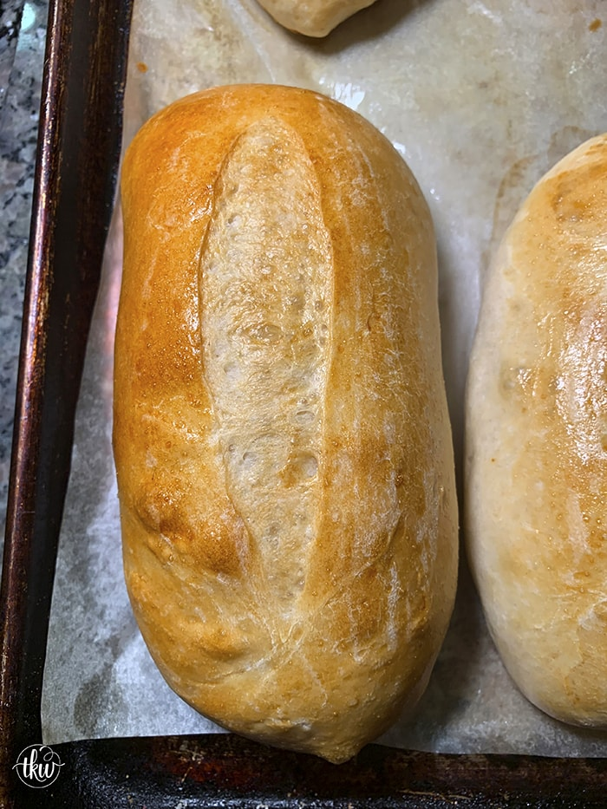
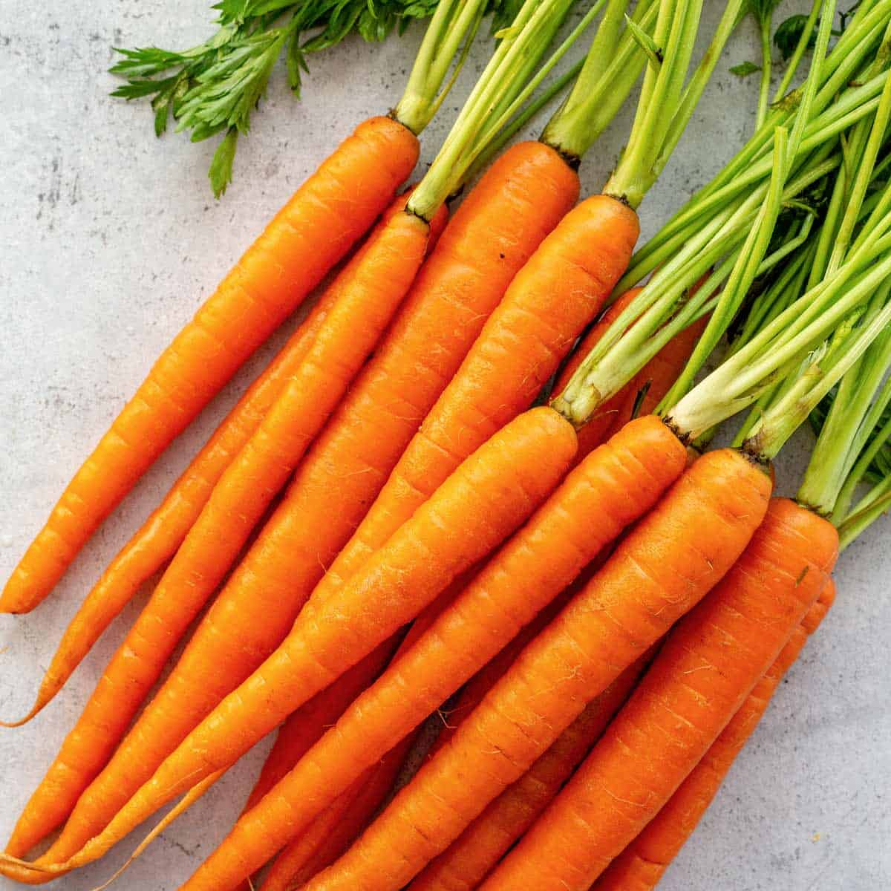
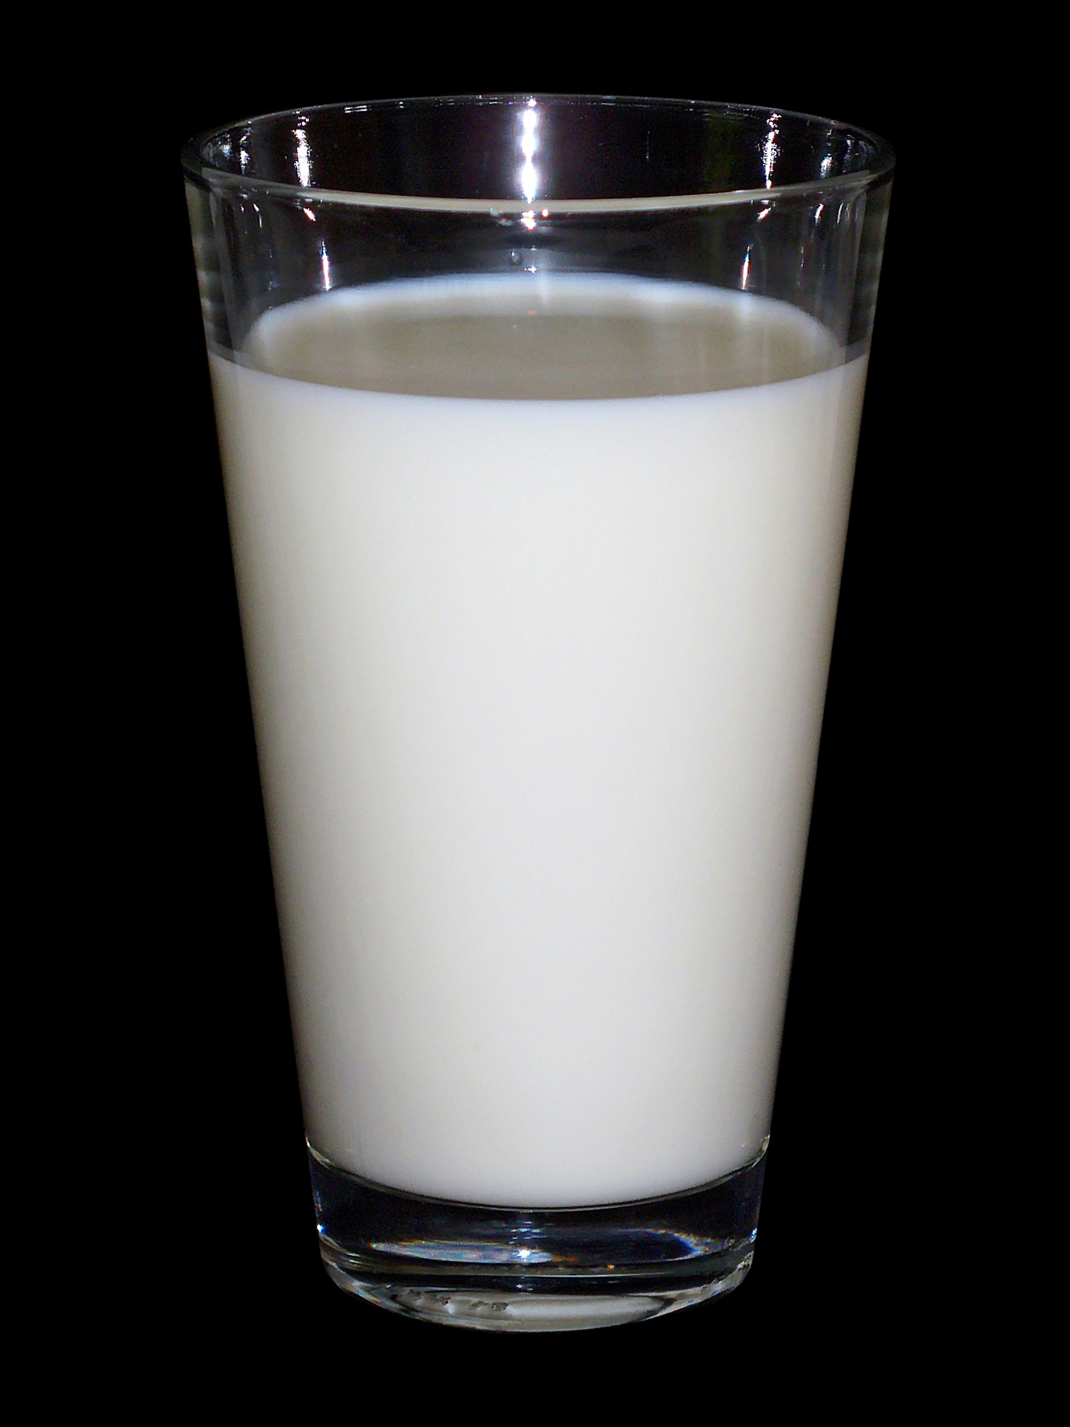
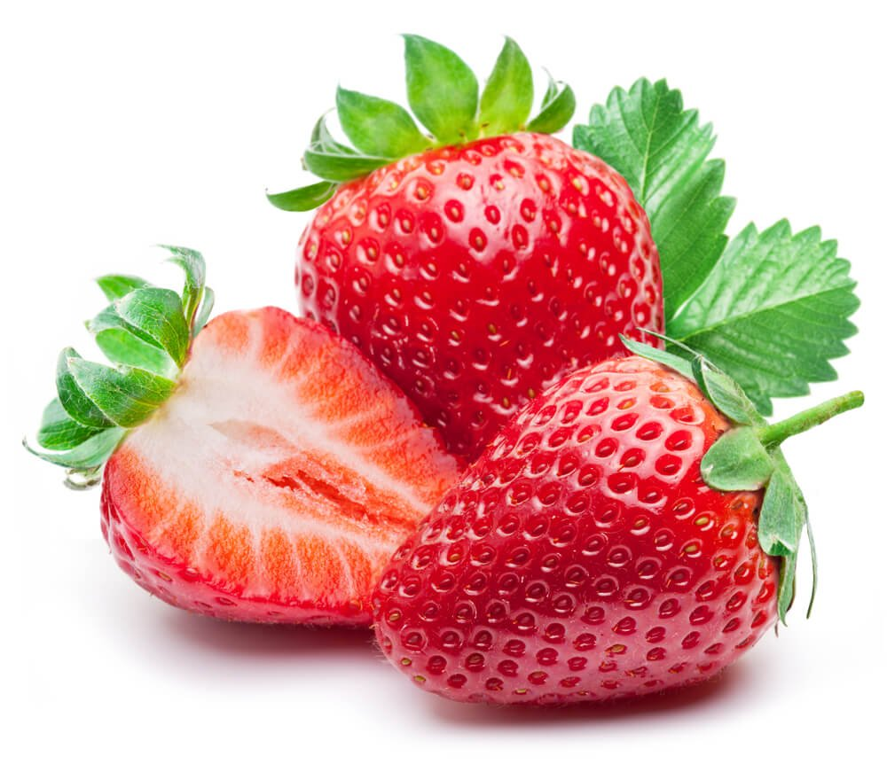
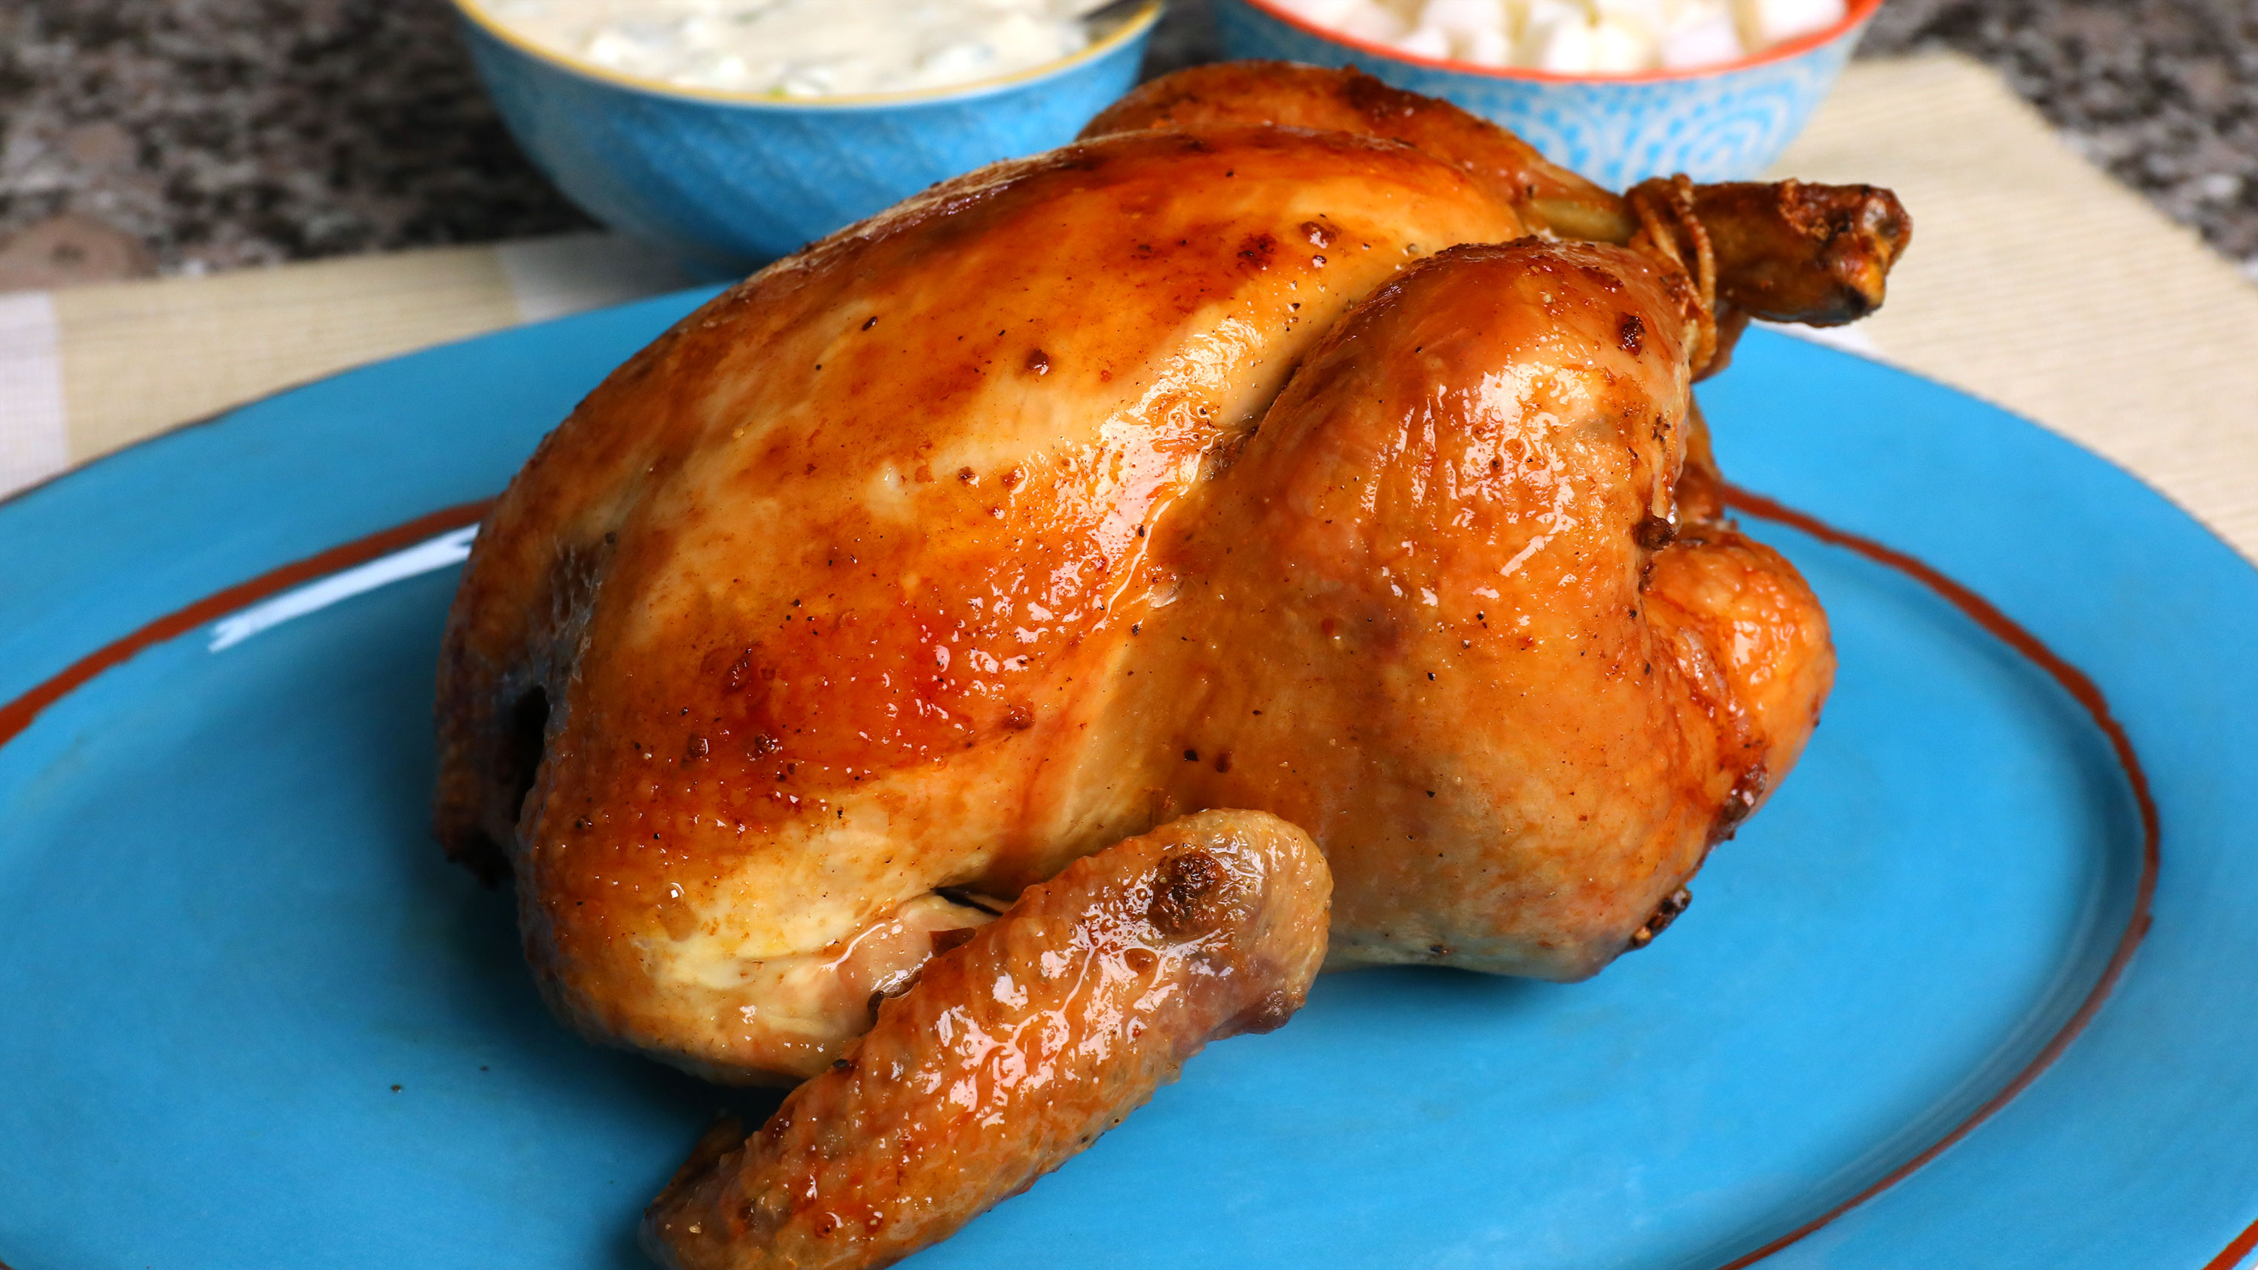
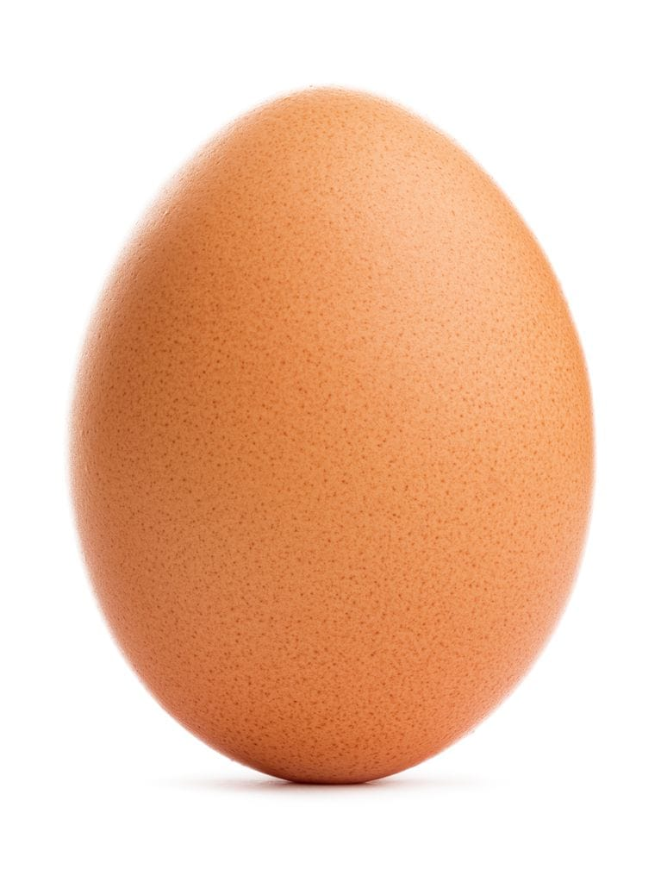
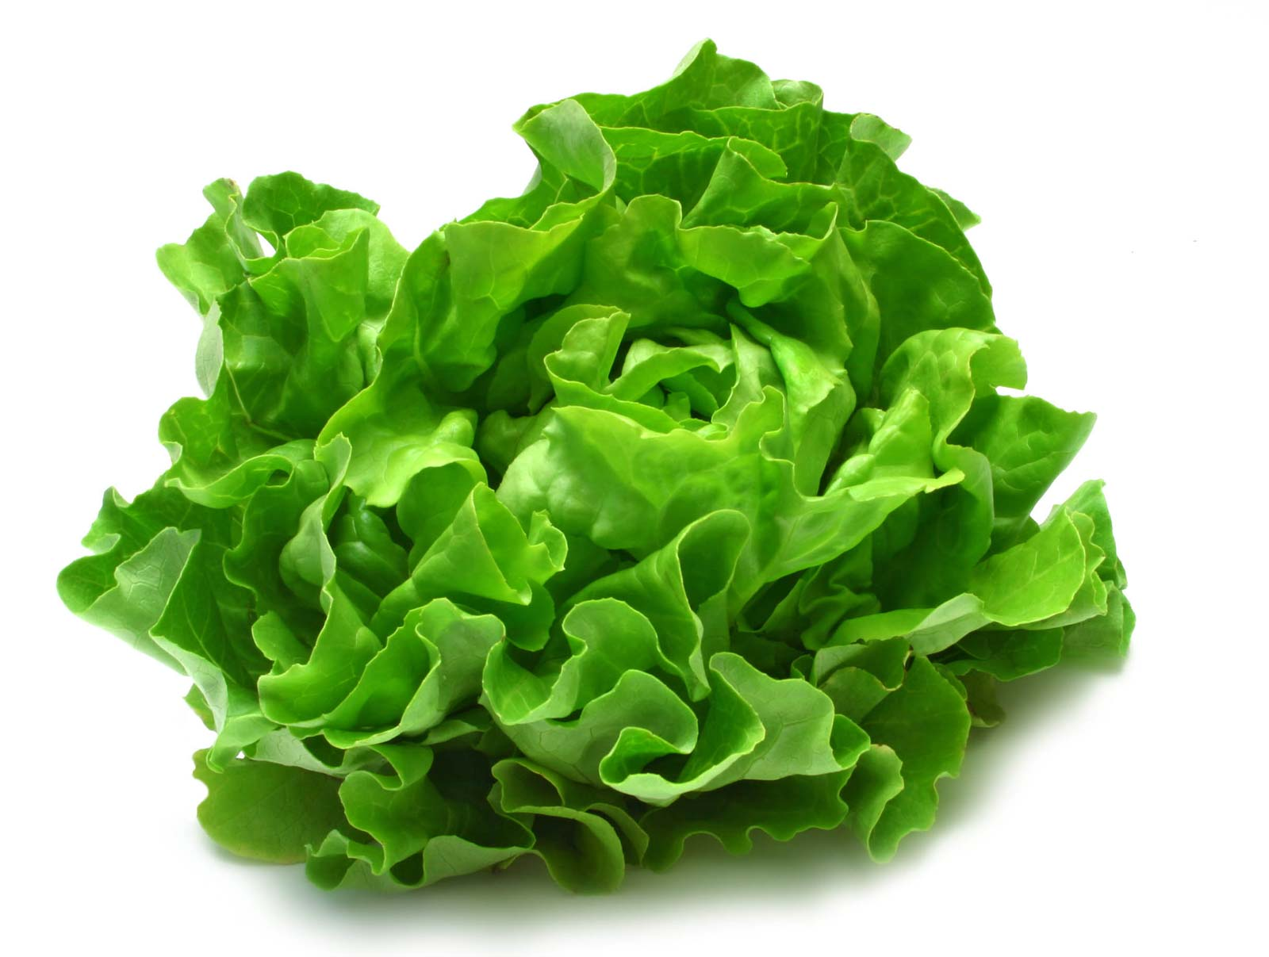
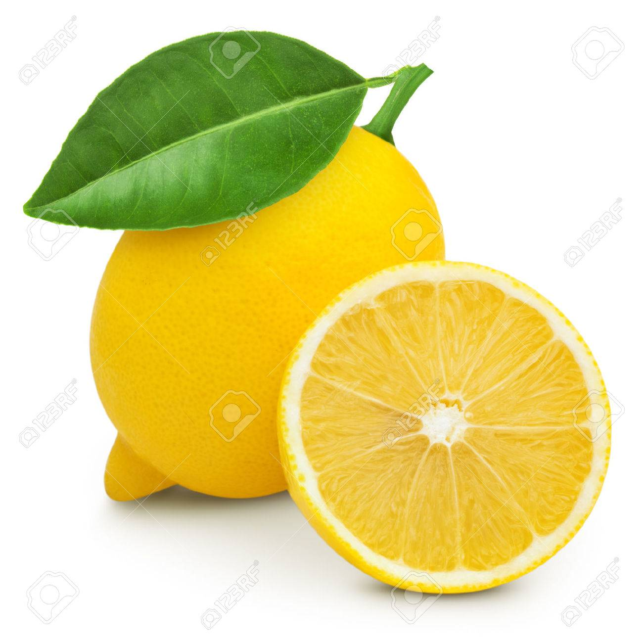
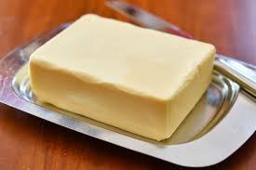
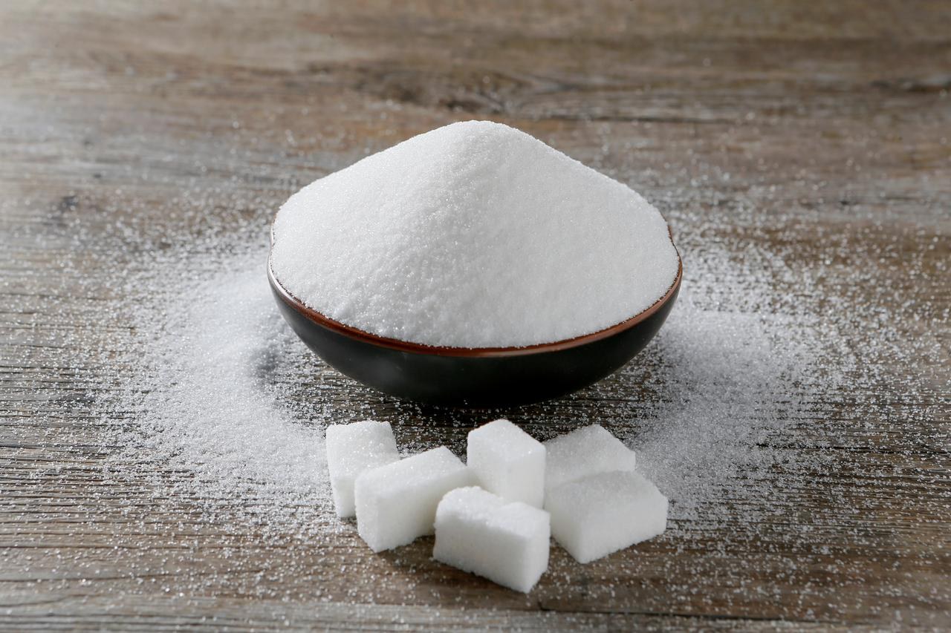
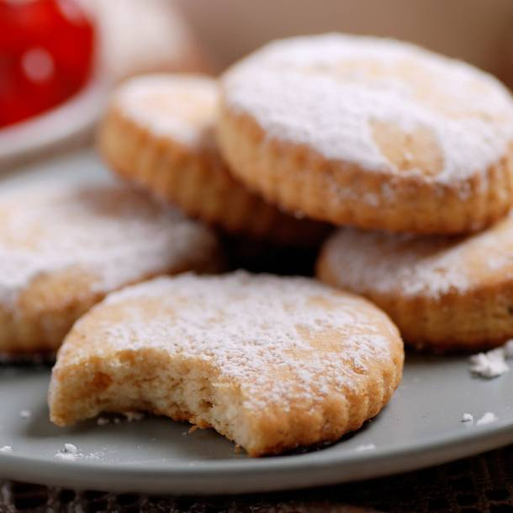
Tomatoes
cucumber
A banana
Green beans
A mixed salad
chicken
A bread roll
Carrots
milk
an egg
strawberries
some butter
A lettuce
sugar
Biscuits / cookies
lemon
cream

Slide 6
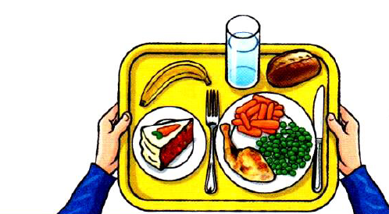
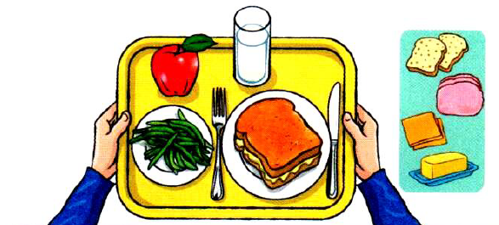
Activity Book – page 28
What are they eating ? (que mangent-ils?)
is having
Chicken with peas and carrots
A grilled cheese sandwich with bread, butter, and cheese.
A carrot cake
Green beans
A banana
A bread roll
An apple
- A glass of water
some milk

Slide 7
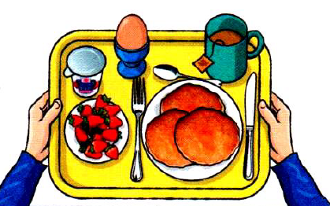
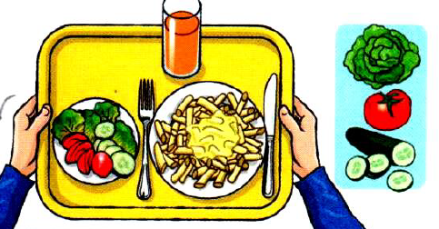
Activity Book – page 20
What are they eating ? (que mangent-ils?)
is having…
is having…
-pancakes
-an egg
-mac and cheese
-strawberries
-a cup of tea
-a mixed salad with lettuce, tomatoes and cucumber
- a yogurt
-a glass of orange juice

Slide 8
Je retiens…Pour exprimer une quantité
A cup of tea
Une tasse de thé
A glass of water
Un verre d’eau
A piece of cake
Un morceau de gâteau
An apple (an+voyelle)
Une pomme
A yogurt (a+consonne) –> le ‘y’ est une consonne en anglais
Carrots
Des carottes
Some milk
Some butter
Some tomatoes
Du lait
Du beurre
Some + nom singulier = du
Quelques tomates
Some + nom pluriel = quelques

Slide 9
Activity Book – page 20
Listen and complete
1. Sarah’s shopping list
2. Chuck’s shopping list
1. 3 apples
1. A chicken
2. Some butter
2. Some carrots
3. Some sugar
3. A lettuce
4. Some cream
4. Some tomatoes
5. some milk
5. Some bread

Slide 10
Maintenant, tu vas faire des exercices sur mon site internet, je vais t’envoyer le lien par message écrit sur ZOOM, tu n’auras plus qu’à cliquer dessus.
Mon site internet s’appelle www.coursfrazier.fr
Il y a une rubrique CM2 c’est très facile
Je mettrai des exercices, des pistes audio ou des vidéos
Thank you !!
Pour les élèves qui sont à l’école, il faut aller sur l’application SAFARI et taper l’adresse dans la barre tout en haut.

