Slide 1
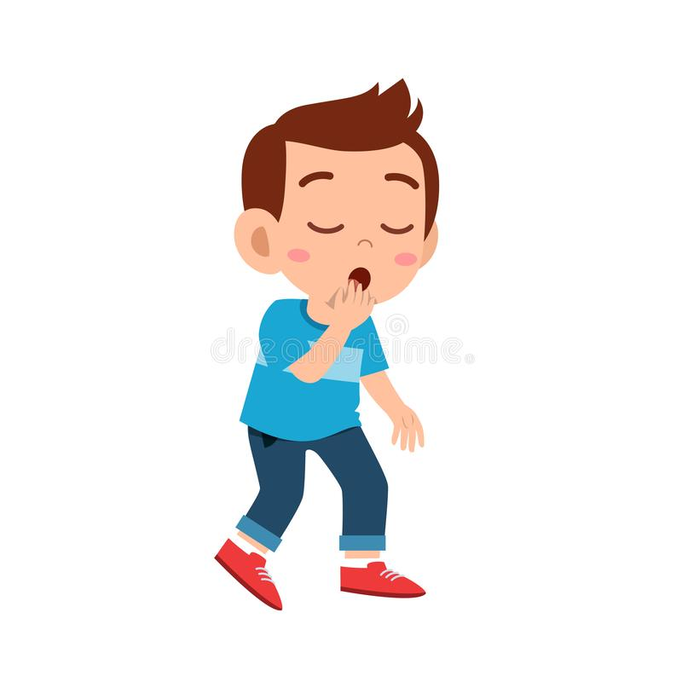
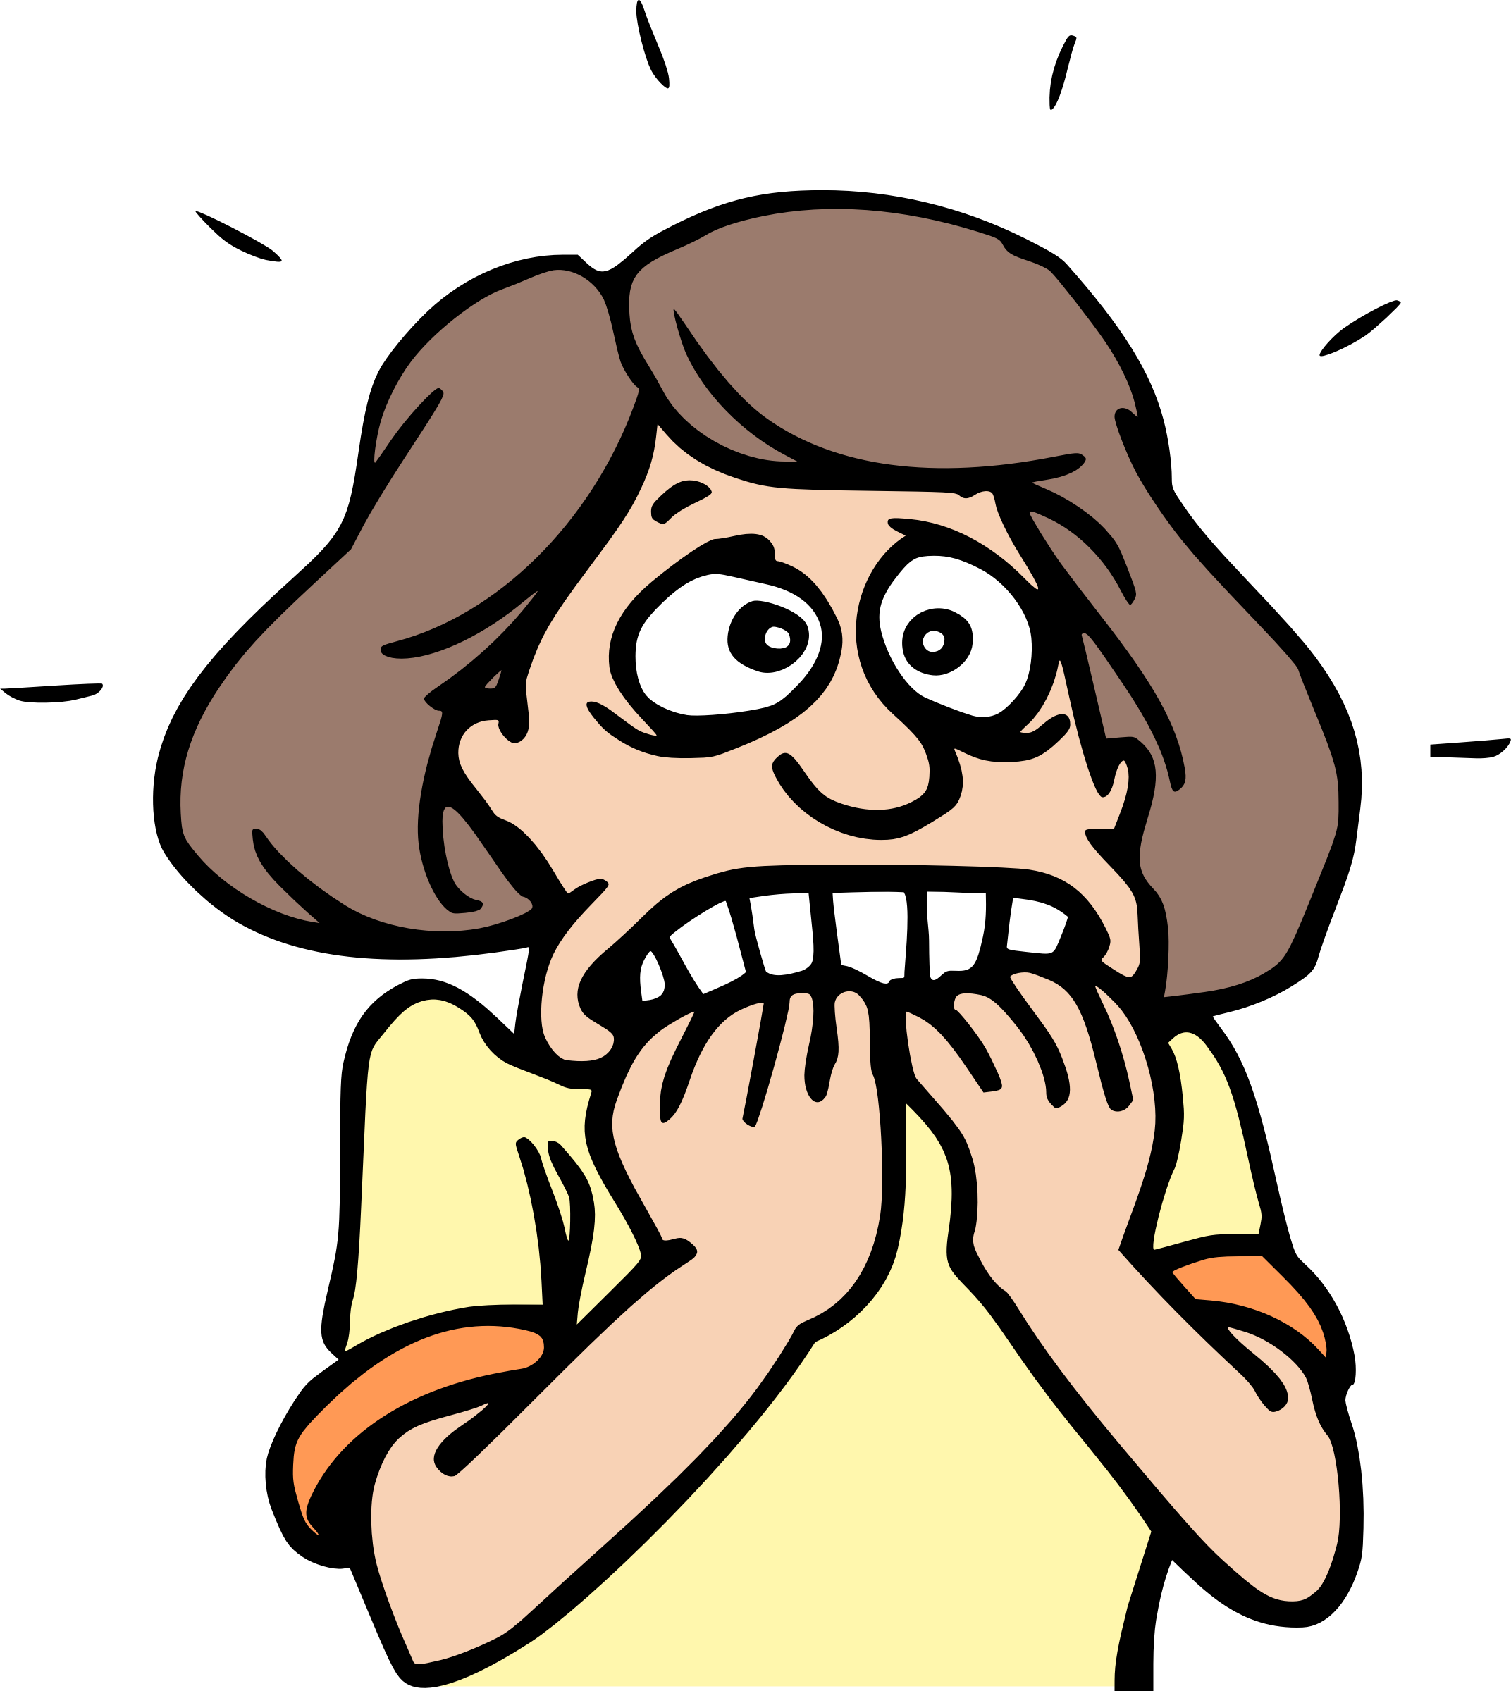
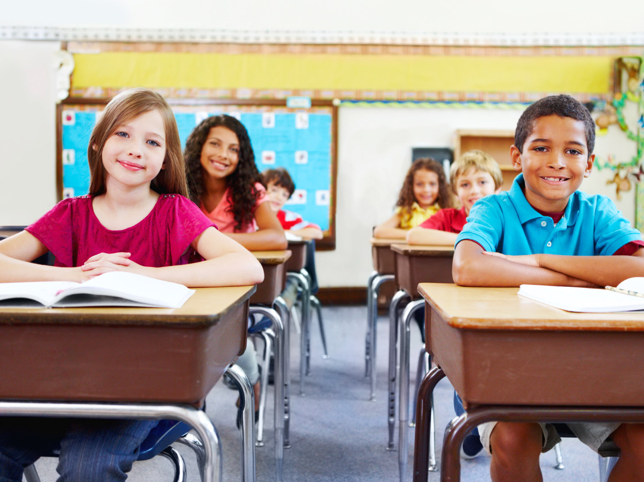
Welcome back to the English class !!!
How are you today ?
I’m tired
I’m nervous
I’m fine
What’s the date today ?
Today is Tuesday, 11th of May
How’s the weather today?
It’s sunny and cool.
Are you at school ?
Yes, I am at school
No, I am at home

Slide 2
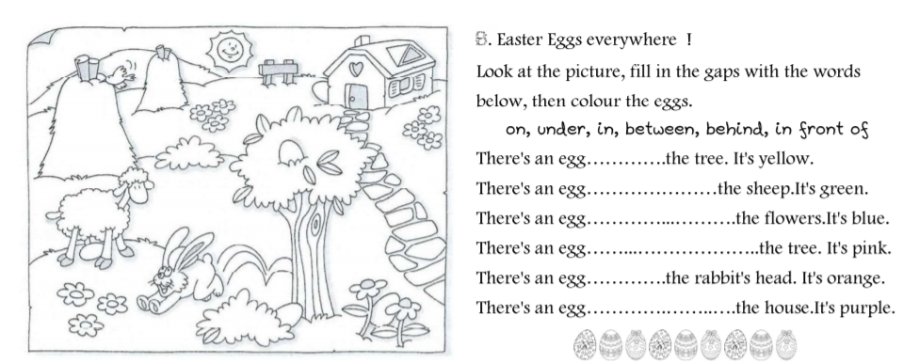
in
under
between
in front of
on
behind /
on the left of

Slide 3
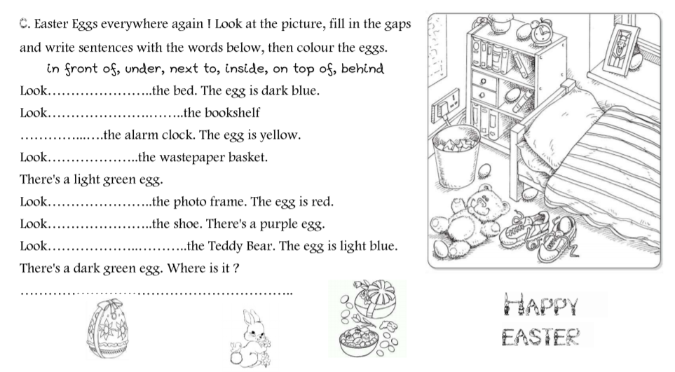
under
on top of
next to
next to
behind
In / inside
in front of
it’s on the left of the book

Slide 4
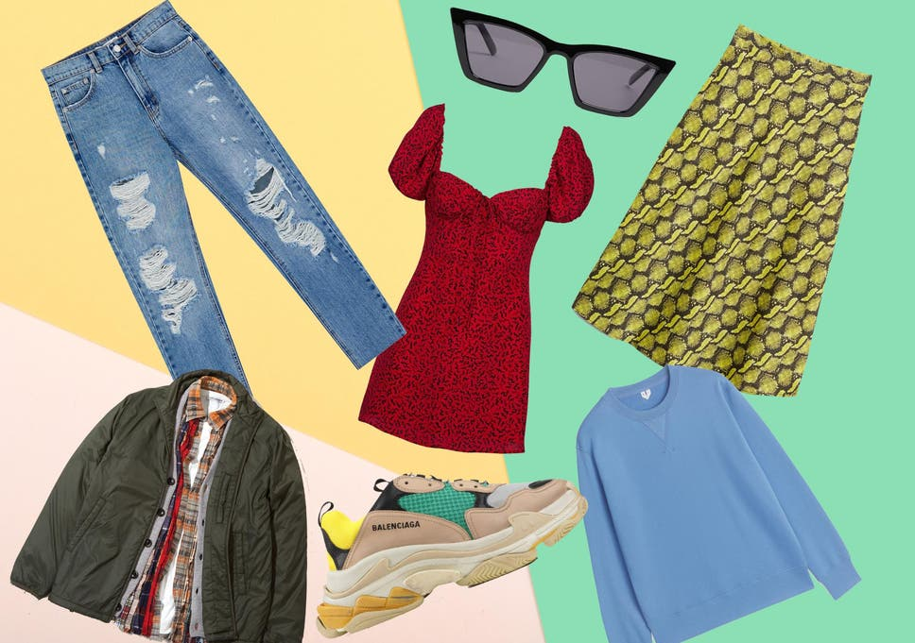
Today we are going to talk about…
CLOTHES

Slide 5
A YELLOW T-SHIRT
GREEN SHORTS
A RED SKIRT
BLUE TROUSERS
A PINK DRESS
AN ORANGE SHIRT
A GREY PULLOVER
A GREY SWEATER
BLACK SHOES
A BLUE JACKET
A PURPLE COAT

Slide 6
JE RETIENS
consonne
voyelle
pluriel

Slide 7
ACTIVITY 1
JACK
LUCY
SIMON

Slide 8
ACTIVITY 2
SHOES
JACKET
TROUSERS
SHIRT

Slide 9
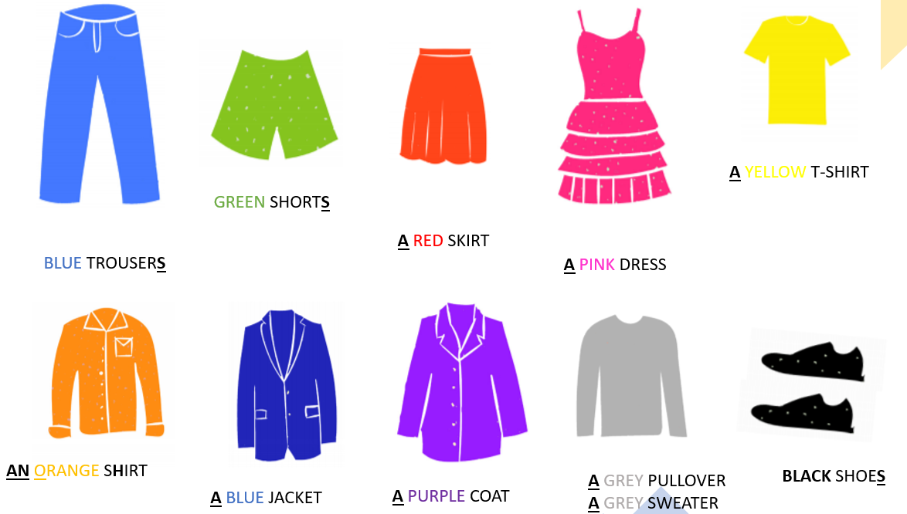
SPEAK
→ Décris les personnages à l’oral
What is Jane wearing ?
Jane is wearing …

Slide 10
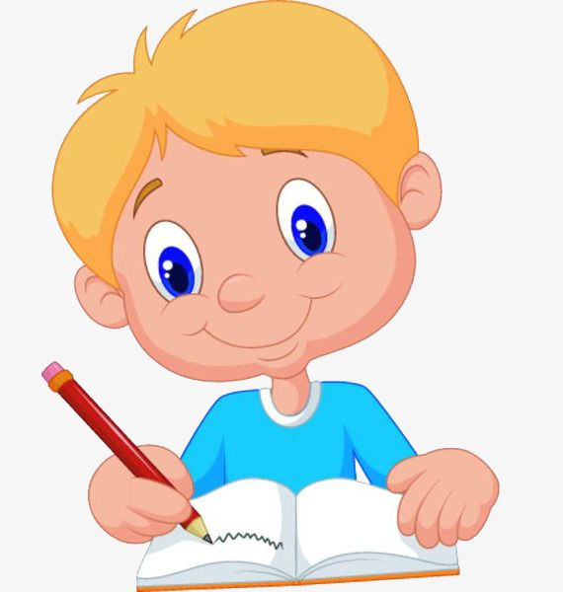
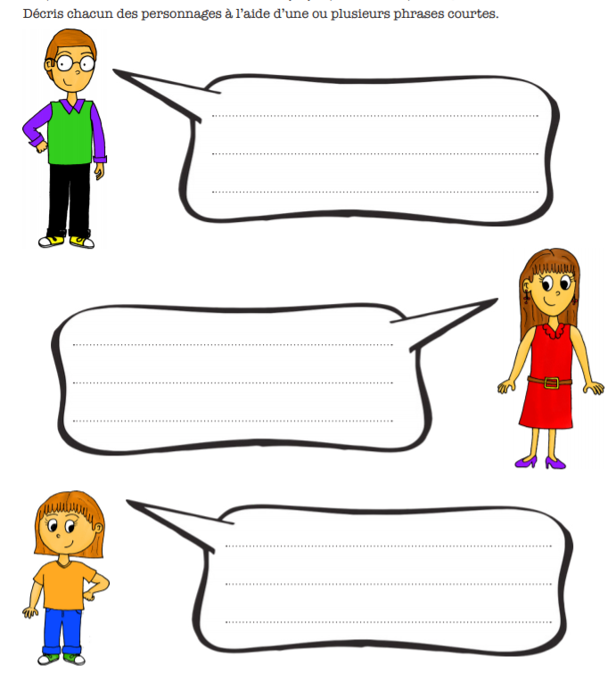
WRITE
I am wearing…
a purple shirt,
a green sweater
black trousers
yellow and white shoes
I am wearing…
a red dress and purple shoes
I am wearing…
an orange t-shirt
blue trousers and green and white shoes

